Slide 1
Barbershop
We created a barbershop appointment booking system to make scheduling easy and efficient for both barbers and clients. With our system, customers can book their preferred time slots hassle-free, reducing wait times and ensuring a smooth experience. Barbers can manage their schedules effortlessly, avoid overbookings, and focus on delivering great service. Our goal is to streamline the booking process, improve customer satisfaction, and help barbershops operate more efficiently.

Slide 2
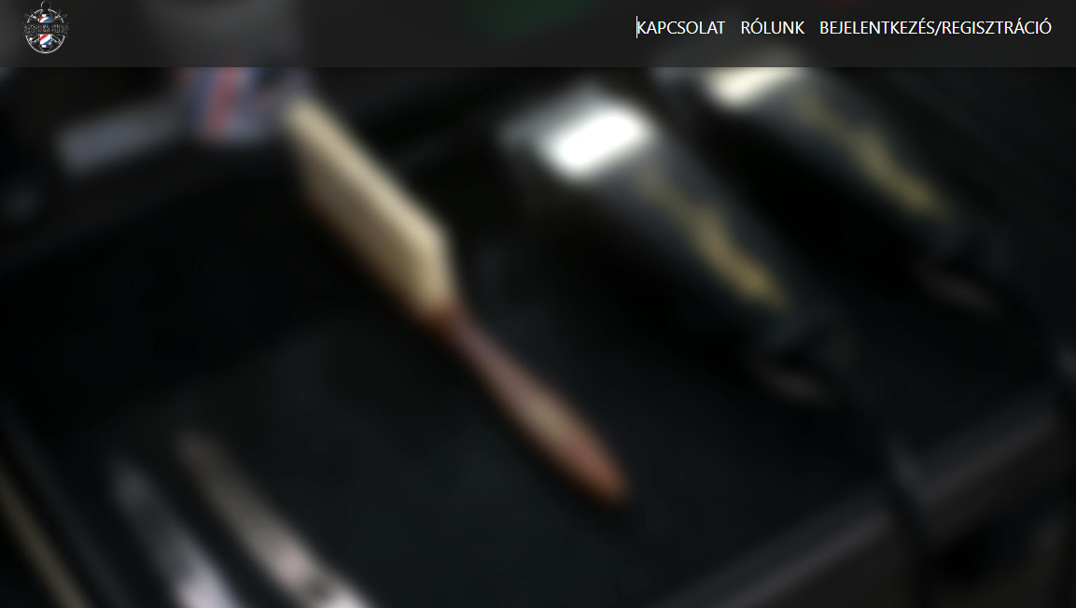
Home page
Navigation Menu Explanation:
At the top of the page, you’ll find our navigation bar with key sections:
Kapcsolat: This leads to our Contact page, where clients can get in touch with us for appointments or inquiries.
Rólunk: The About Us section shares our story, values, and what sets us apart in the barbering industry.
Bejelentkezés/Regisztráció: This is the Login/Registration portal, allowing clients to book appointments or create an account for easier future bookings."

Slide 3
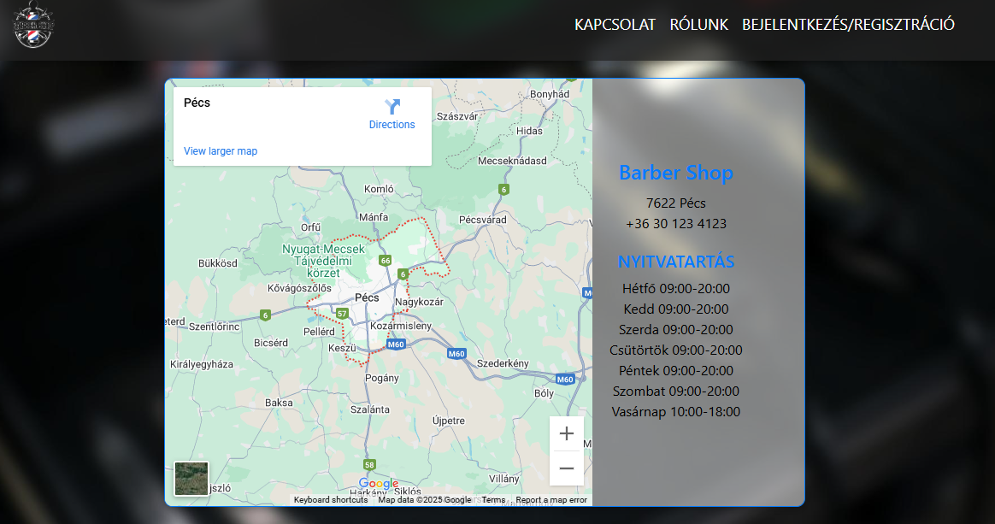
Contact Information & Opening Hours
Location:
Our barbershop is located in the heart of Pécs, Hungary. You can easily find us using the embedded Google Maps on our website for clear and accurate directions.
Contact Details: 📍 Address: 7622 Pécs 📞 Phone: +36 30 123 4123
Opening Hours: We offer flexible hours to accommodate your needs:
Monday to Saturday: 09:00 AM – 08:00 PM
Sunday: 10:00 AM – 06:00 PM

Slide 4
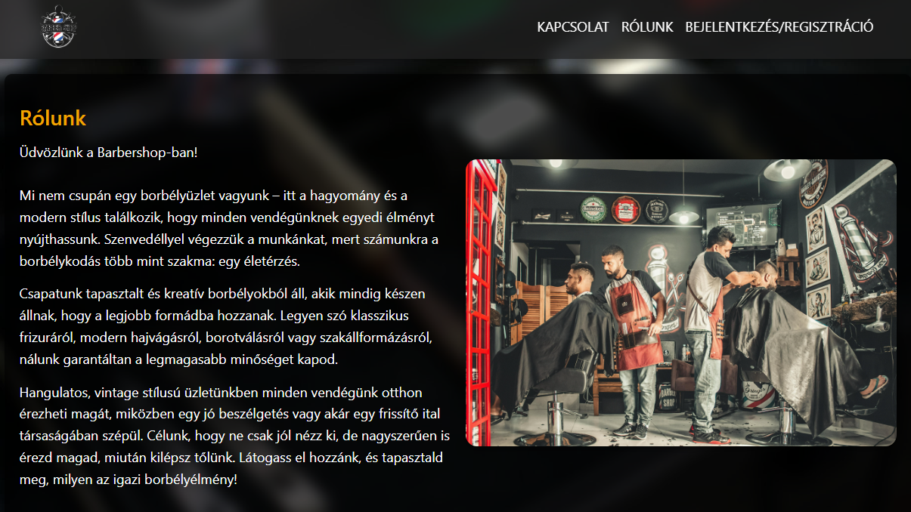
About Us
Who We Are: More than just a barbershop, blending tradition and modern style with passion and dedication.
Our Team: Skilled and experienced barbers offering classic and modern haircuts, shaving, and beard grooming.
Quality & Experience: Commitment to excellence, personalized service, and a relaxing experience.
Our Ambience: Vintage-style interior, comfortable atmosphere, great conversations, and refreshments.
Visit Us!: Enhance your look and confidence with top-tier barbering—open invitation to experience it.

Slide 5
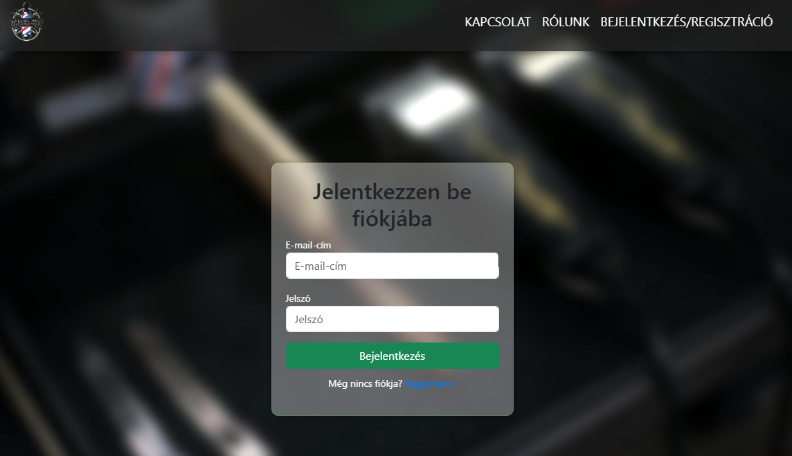
Login
Login Form: Users enter their email address and password to access their accounts.
Button (Green): The "Bejelentkezés" (Login) button allows users to sign in.
Registration Option: If a user doesn't have an account, they can click on "Regisztráció" (Registration) to create one.

Slide 6
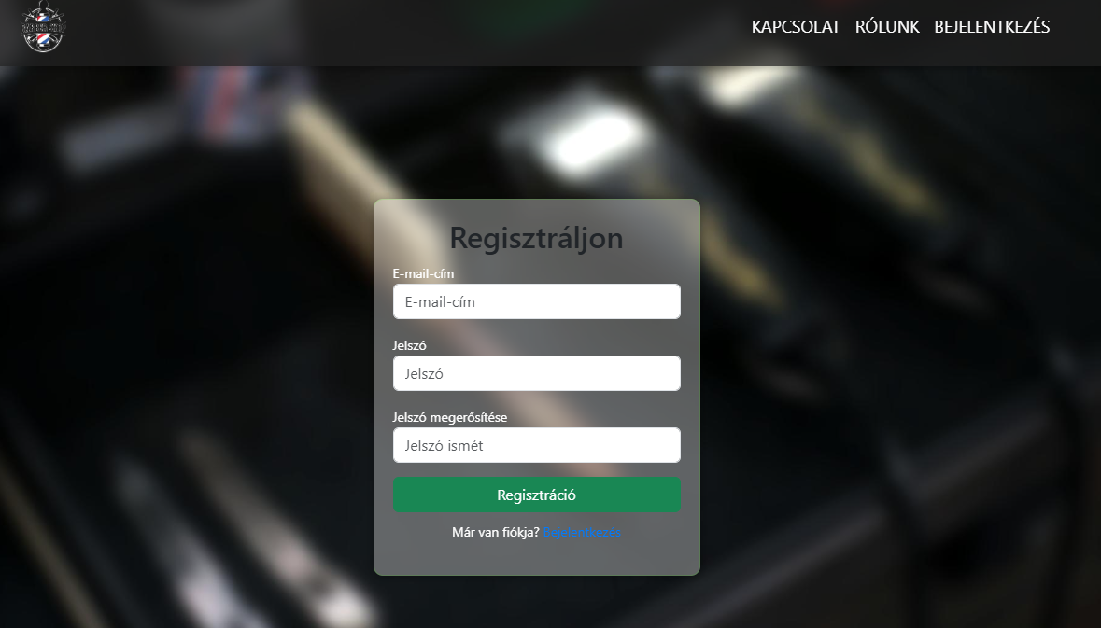
Registration
Registration Form: Users enter their email address, password (must be at least 8 characters long and include lowercase and uppercase letters plus a special character), and confirm their password to create an account.
Green Registration Button: Clicking "Regisztráció" (Register) submits the form.
Login Option: If users already have an account, they can click "Bejelentkezés" (Login) to switch to the login page.
Confirmation Email: After registering, users will receive a confirmation email with their registration details.

Slide 7
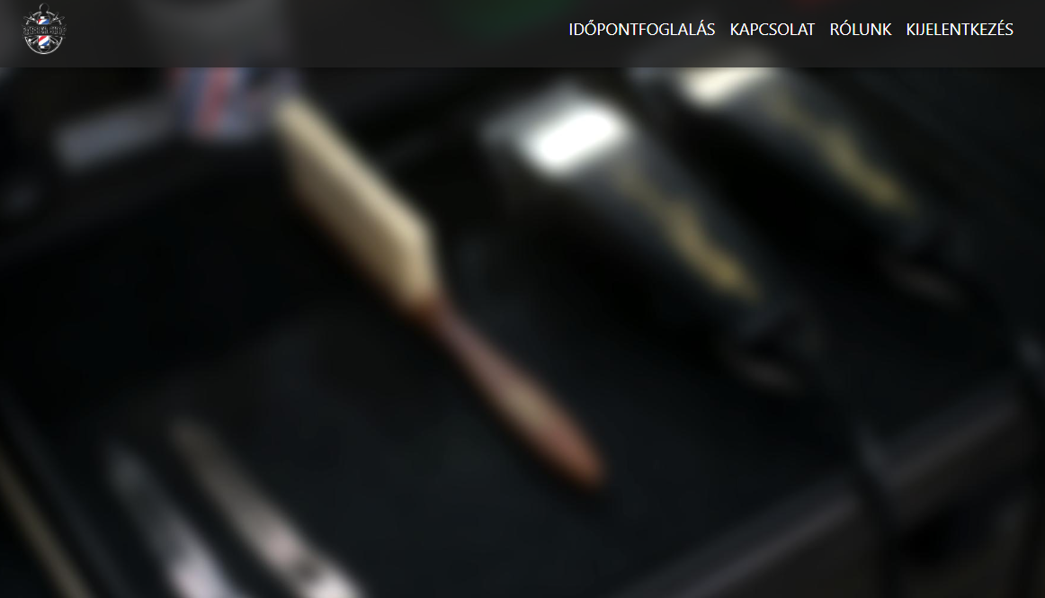
Loggined Home page
After logging into the system, users are redirected to a page displaying the appointment-booking section, if they are an admin, the Admin page is also displayed, and the Login/Register link changes to Logout.

Slide 8
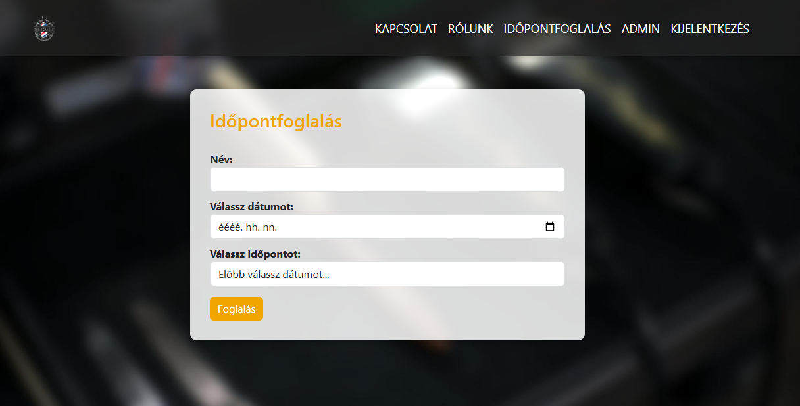
Appointment
Name (Név) – required; users must enter a name before booking.
Date (Válassz dátumot:) – weekdays only (Mon–Fri)
Time (Válassz időpontot:) – slots available 09:00–15:30. Each slot can be reserved by only one user.

Slide 9
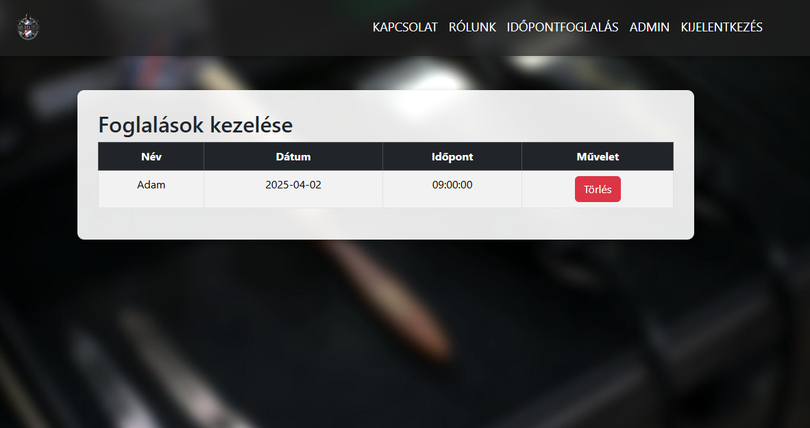
Admin
When an admin clicks the Admin page, they’re taken to the Manage Bookings page, which displays all appointments in a table:
Name: the user who made the booking
Date: the booked weekday (Mon–Fri)
Time: the reserved time slot
Action: a Delete button allowing the admin to cancel that booking
Only administrators can access this page.

Slide 10
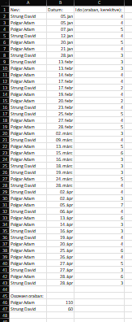
Teamwork
110h

Slide 11
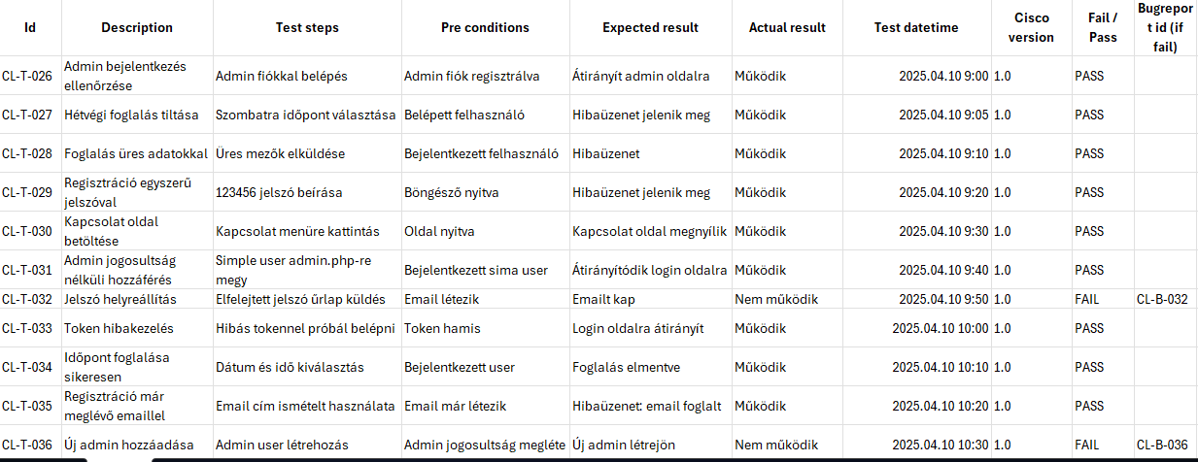
Tests
We have completed a total of 55 manual tests.

Slide 12
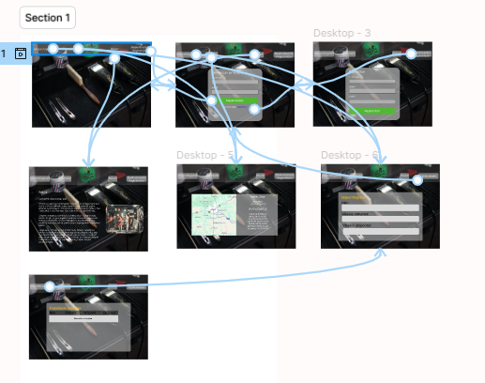
Figma Design
This is our live Figma design, it was the original plan that we tweaked slightly during development for a better appearance.

Slide 13
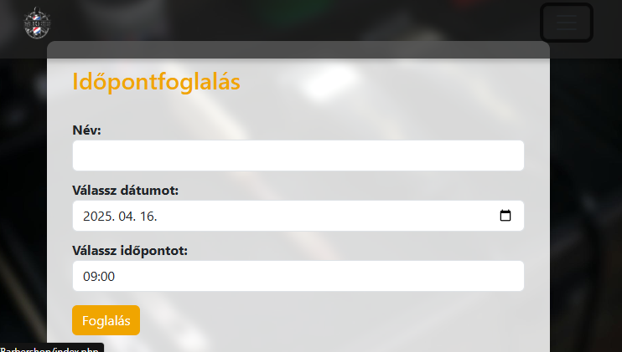
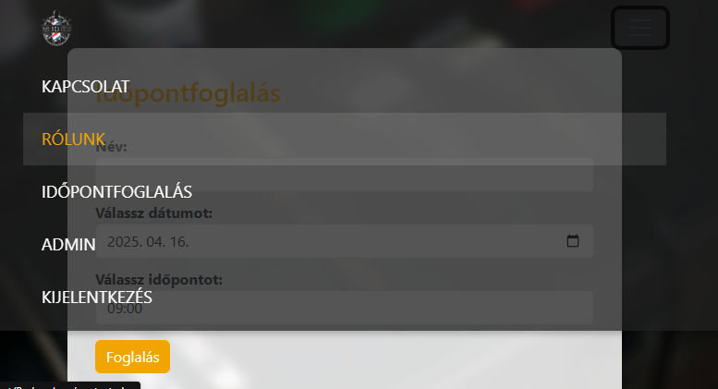
Responsive Design and JWT Token
Responsive Design:
Our interface is fully responsive, automatically adapting to any screen size. On mobile devices, the top navigation collapses into a hamburger menu that slides in as an overlay—preserving easy access to all links—while the booking form and buttons resize and reflow for optimal readability and touch-friendly interaction.
JWT Token:
Every page that requires authorization (admin panel, booking form, API endpoints) validates the token stored in the user’s cookie. If the token is missing or invalid, the system redirects the user to the login page.

